Slide 1

ITM VOCATIONAL UNIVERSITY
Project Based Learning
Shlok Ashish Jaiswal
160110424001
B-Tech CSE(DS)
Topic - Restaurant Website

Slide 2
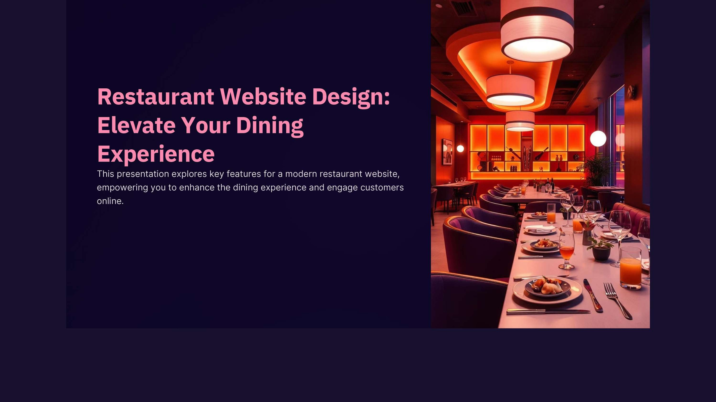

Slide 3
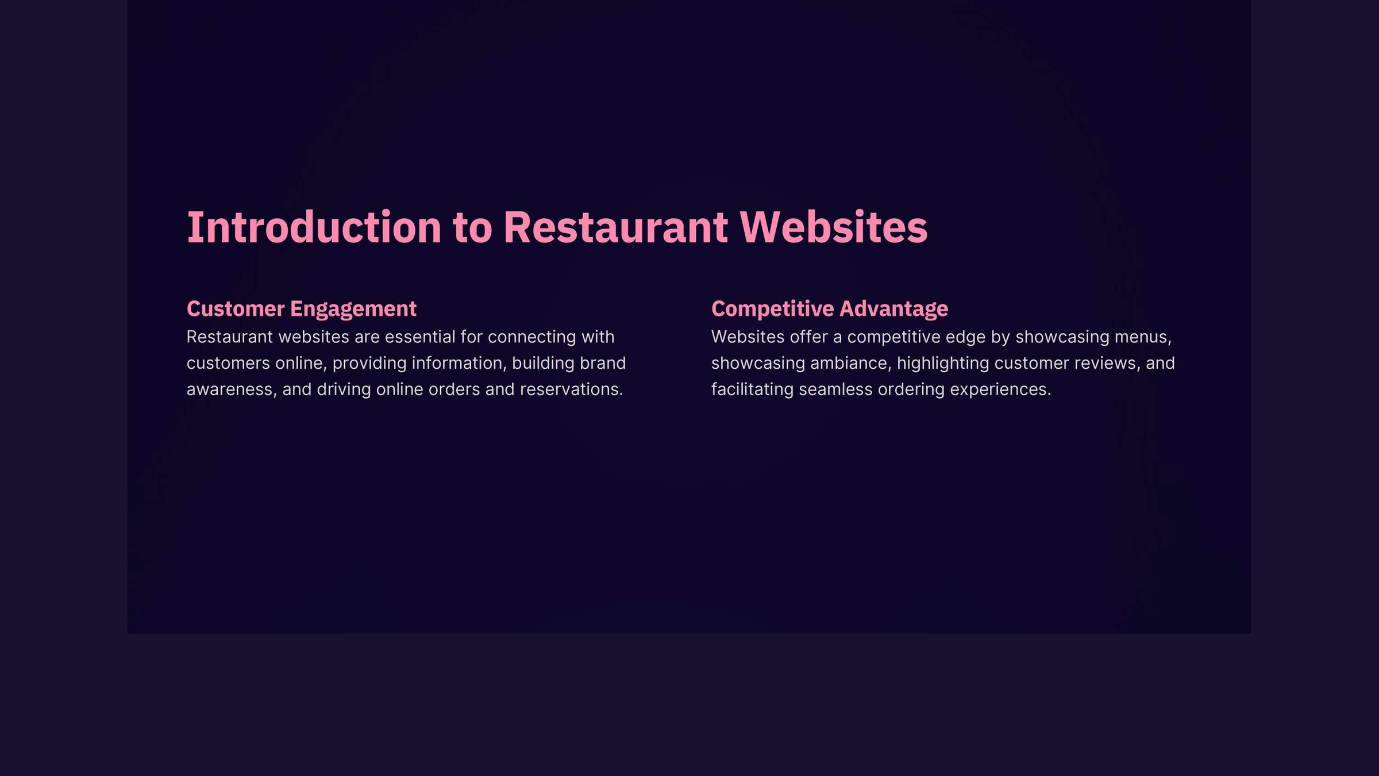

Slide 4
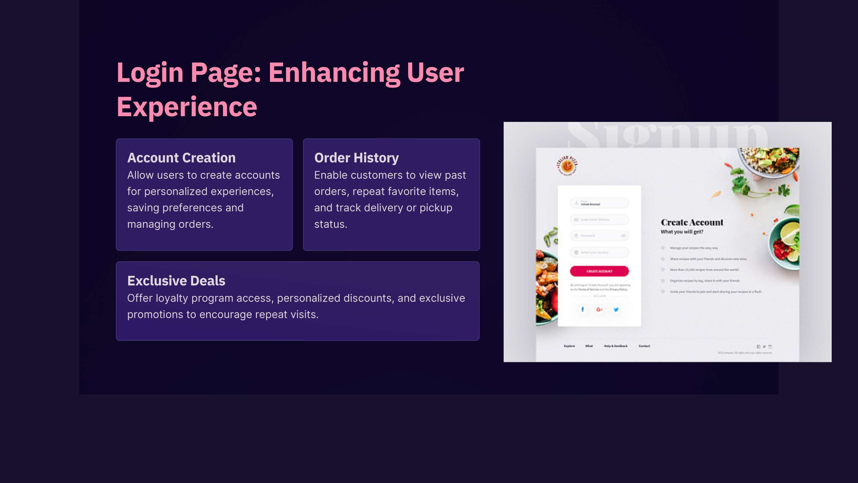

Slide 5
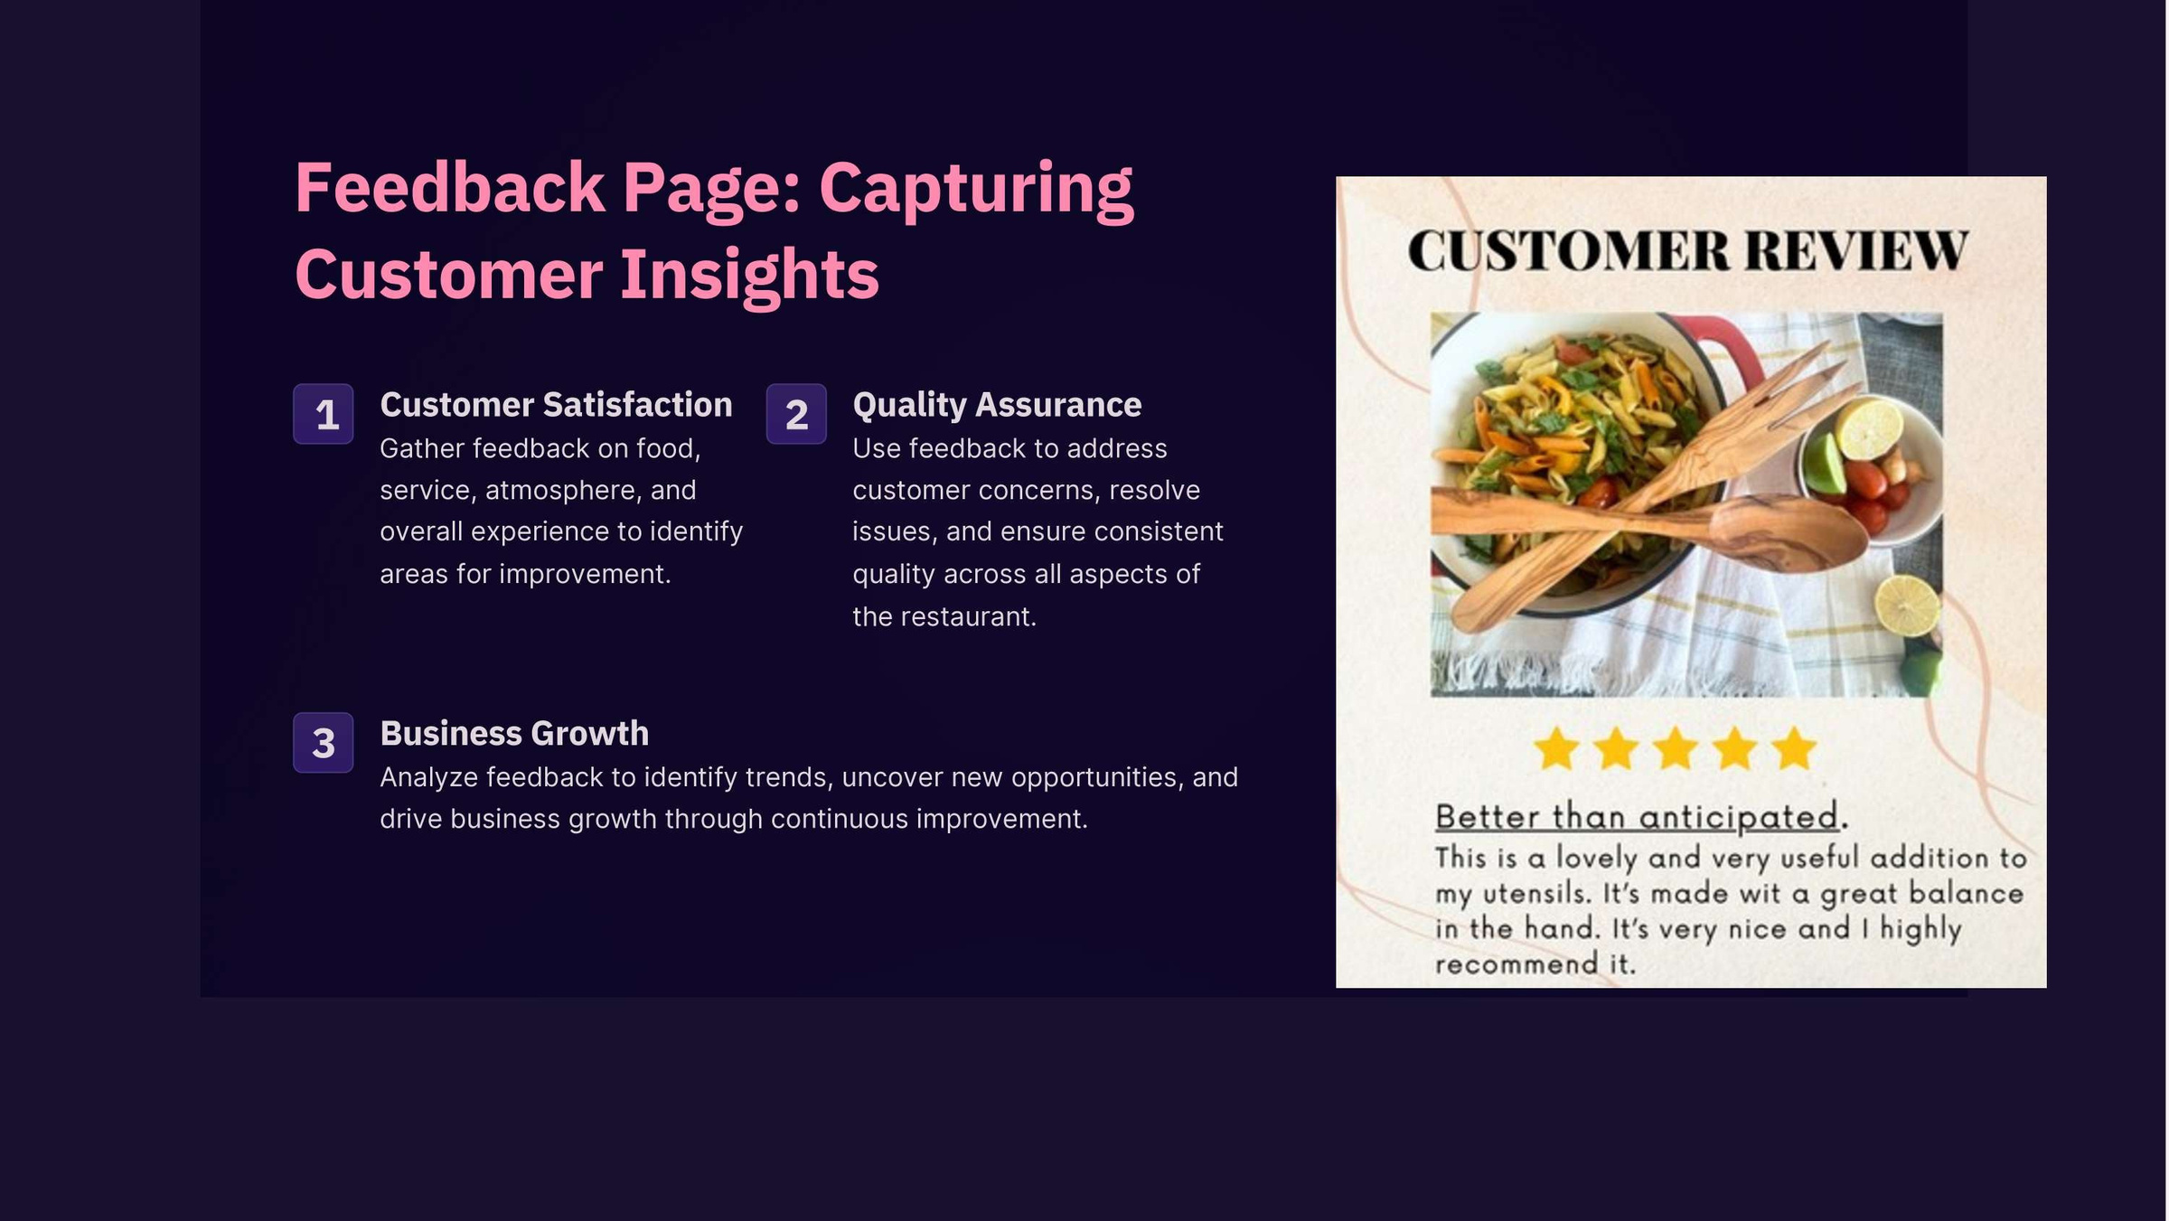

Slide 6
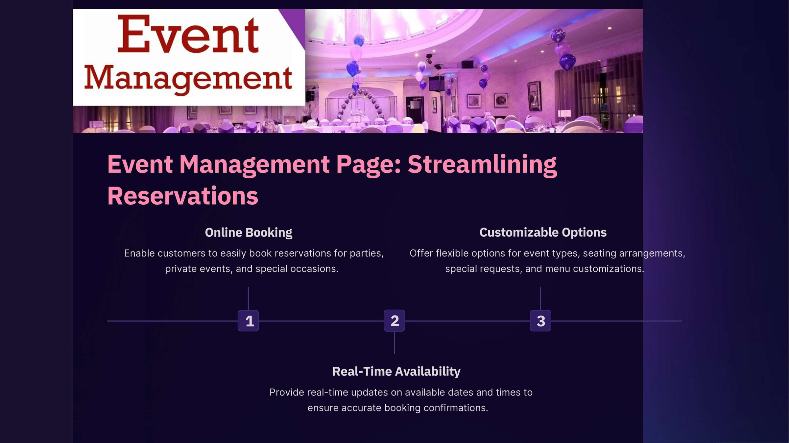

Slide 7
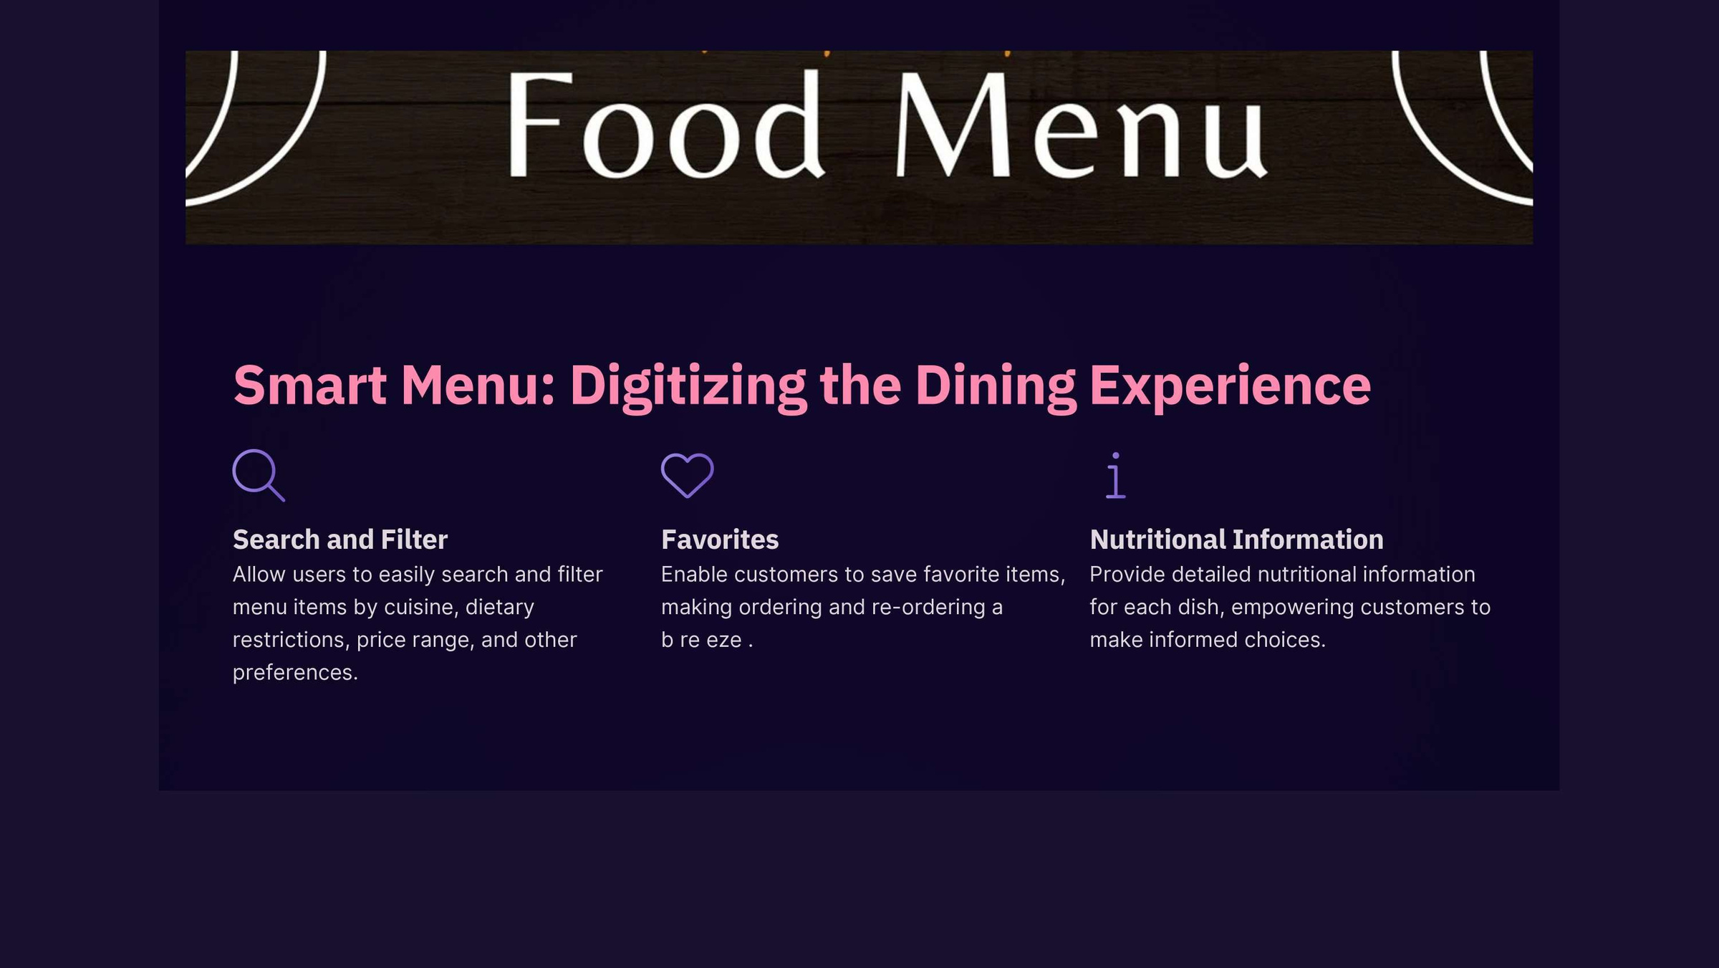

Slide 8


Slide 9
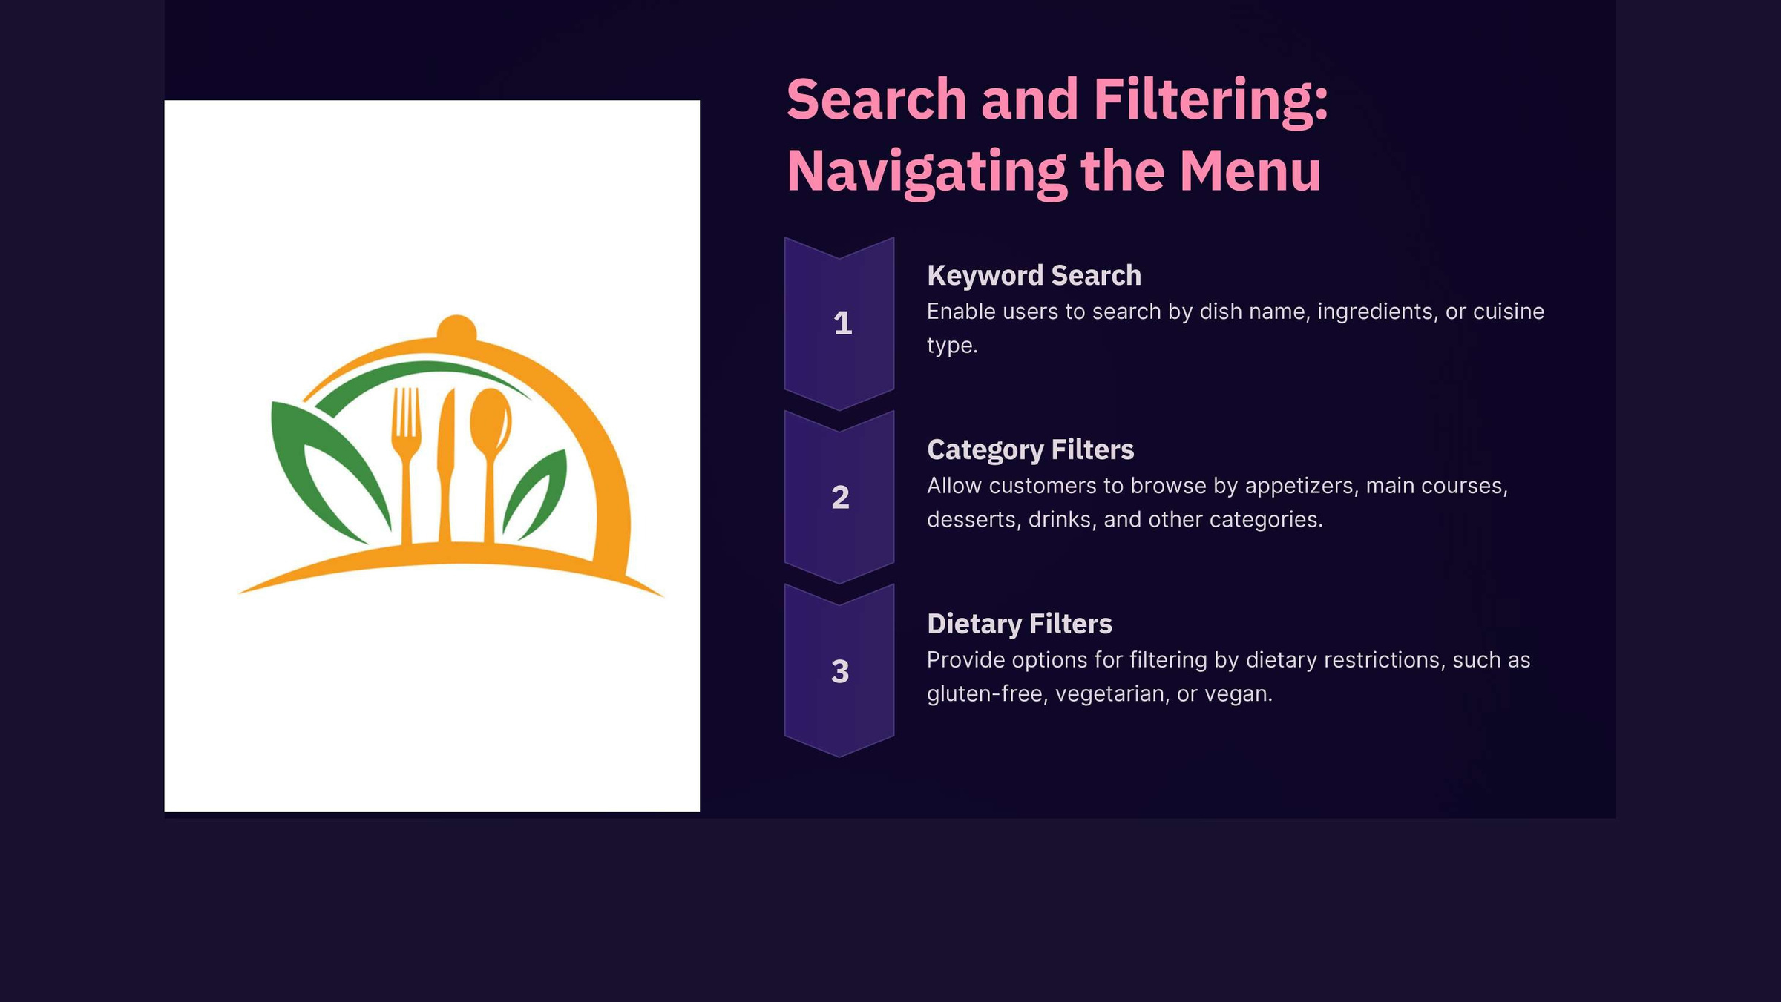

Slide 10
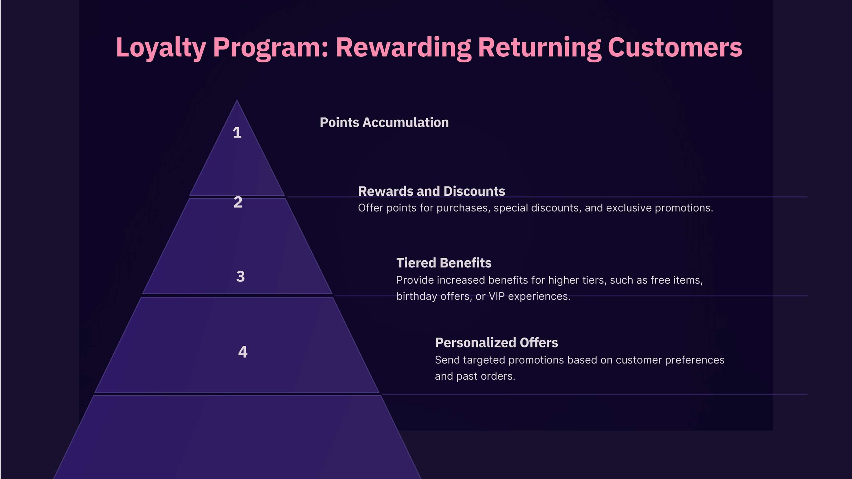

Slide 11
